Slide 1
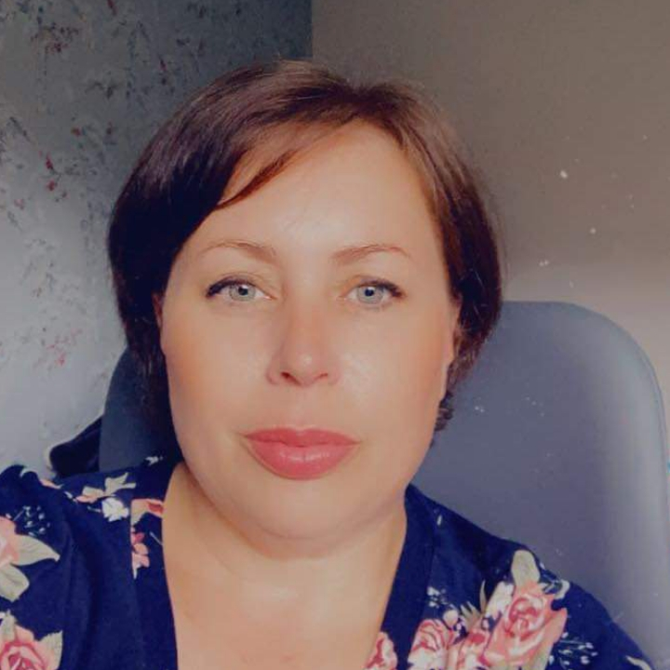
Sara Legge
Chair of Cinderford Town / Welfare Officer
07535012213
chairman@cinderfordtown.co.uk

